Slide 1
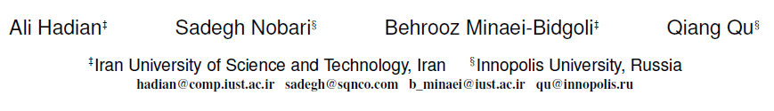
ROLL：Fast In-Memory Generation of Gigantic Scale-free Networks
SIGMOD 2016
Qianqian Wang
2016.08.08

Slide 2
Outline
Problem Definition
Existing Method
Proposed Method
Analysis
Conclusion

Slide 3
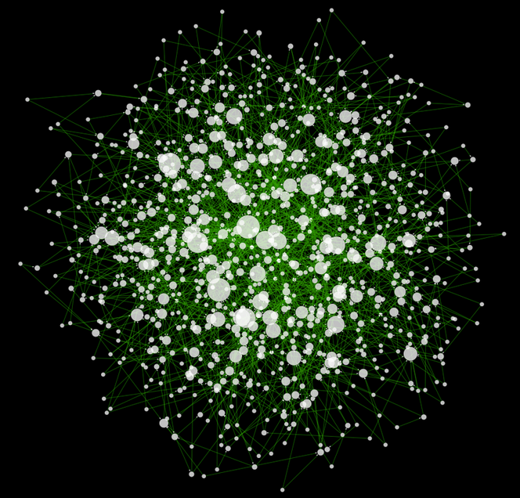
Problem Definition
Scale-free network
complex network
Random network
1

Slide 4
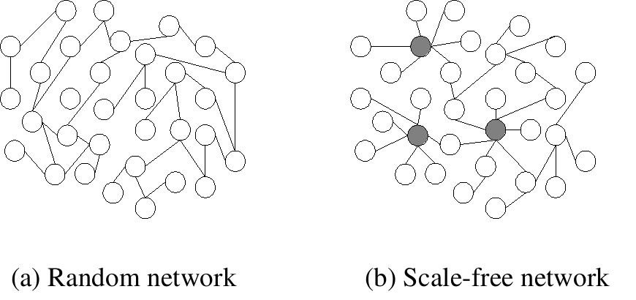
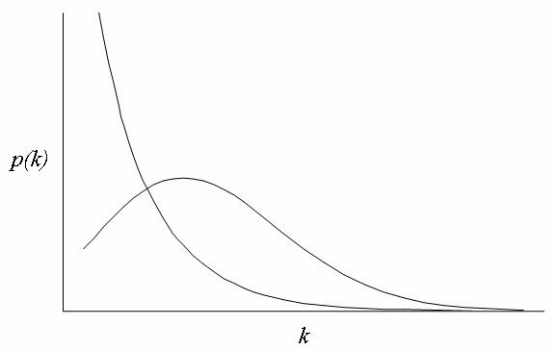
Problem Definition
Degree
the number of connections or edges the node has to other nodes
power-law distribution
p(k)
normal distribution
k
2
Notes:
random:大部分节点连出2-3条边 Scale-free:少数节点连有大量边

Slide 5
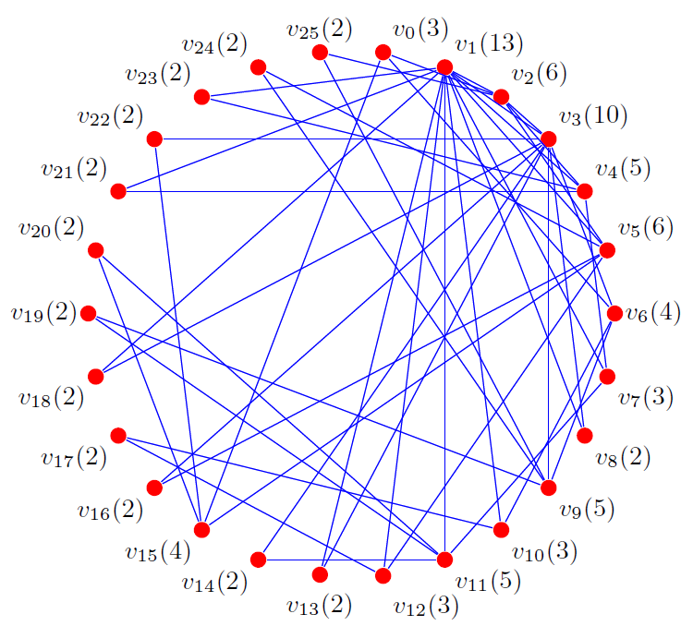
Problem Definition
v₂₅(2)
v₀(3)
Scale-free Networks
v₂₄(2)
v₁(13)
v₂₃(2)
v₂(6)
v₂₂(2)
v₃(10)
BA model
v₂₁(2)
v₄(5)
1. start with a small number of nodes
v₂₀(2)
v₅(6)
2. preferential attachment
v₁₉(2)
v₆(4)
“rich-get-richer” manner
v₁₈(2)
v₇(3)
v₁₇(2)
v₈(2)
v₁₆(2)
v₉(5)
v₁₅(4)
v₁₀(3)
v₁₄(2)
v₁₃(2)
v₁₂(3)
v₁₁(5)
m = m₀ = 2
3

Slide 6
Outline
Problem Definition
Existing Method
Proposed Method
Analysis
Conclusion

Slide 7
Existing Method
SimpleRW Algorithm
(Baseline)
Generate scale-free graphs
SA Algorithm
(State-of-the-art)
4

Slide 8
Existing Method
SimpleRW Algorithm
preferential attachment algorithm
v_{i}
w_{i} = deg(v_{i})
p(v_{i})
P(v_{i})
roulette wheel mechanism :
v₀
3
0.03
0.03
1.generate a random number 0 < x ≤1
v₁
13
0.14
0.17
2.select v_{k} for which P(v_{k-1}) < x ≤ P(v_{k})
v₂
6
0.06
0.23
v₃
v₂₆
v₃
10
0.10
0.33
…
…
…
…
for the first connection :
0.3
v₁₂
3
0.03
0.71
v₁₃
P(v₂) = 0.23 < 0.30 ≤ 0.33 = P(v₃)
v₁₃
2
0.02
0.73
…
…
…
…
for the second connection :
0.72
v₂₄
2
0.02
0.98
P(v₁₂) = 0.71 < 0.72 ≤ 0.73 = P(v₃)
v₂₅
2
0.02
1.00
5

Slide 9
Existing Method
SimpleRW Algorithm
preferential attachment algorithm
v_{i}
w_{i} = deg(v_{i})
p(v_{i})
P(v_{i})
roulette wheel mechanism :
v₀
3
0.03
0.03
1.generate a random number 0 < x ≤1
v₁
13
0.14
0.17
2.select v_{k} for which P(v_{k-1}) < x ≤ P(v_{k})
v₂
6
0.06
0.23
v₃
v₃
10
0.10
0.33
the computational complexity:
…
…
…
…
update for each link : O(n = |V|)
v₁₂
3
0.03
0.71
v₁₃
random number generation : O(1)
v₁₃
2
0.02
0.73
…
…
…
…
total (contain |E|) : O(|E| • (|V| + 1))
= O(mn²)
v₂₄
2
0.02
0.98
v₂₅
2
0.02
1.00
|E| = m( n – m₀ )
6

Slide 10
Existing Method
SimpleRW Algorithm
(Baseline)
Generate scale-free graphs
SA Algorithm
(State-of-the-art)
7

Slide 11
Existing Method
SA Algorithm
1.Select a random node v_{i}
2.Accept the selection with probability p_{acc}(v_{i}) = w_{i} / w_{max}
w_{max} is the maximum weight in the roulette wheel
O(w_{max} / )
complexity:
select one node
O( )
p (k) ~ k ^{- γ}
γ = 3
total:
O(n^{3/2})
E(w_{max}) = n^{1/ (γ-1)}
E(w_{max}) ≈
= 2|E|/|V| = 2(m(n – m₀))/n ≈ 2m
roulette wheel n × m times
8
select a single item from a roulette wheel O(w_{max} / )

Slide 12
Outline
Problem Definition
Existing Method
Proposed Method
Analysis
Conclusion

Slide 13
Proposed Method
provide two operations:
1.sample a random node
2.update the weight of an item
two modifications on the SimpleRW algorithm
ROLL-bucket
group together items with the same probabilities
reduce the problem size
ROLL-tree
use multiple random binary decisions to select the target item
avoid traversing a large list of buckets
9

Slide 14
Proposed Method
Roulette Wheel Buckets (ROLL-bucket)
group the nodes with the same weight into the same bucket
Bucket
Degree d
# Nodes
p(B_{d})
P(B_{d})
Nodes
B₂
2
13
26/96
26/96
{v₈, v₁₃ , v₁₄ , v₁₆ ,… , v₂₃ , v₂₄ , v₂₅}
B₃
3
4
12/96
38/96
{v₀, v₇ , v₁₀ , v₁₂}
B₄
4
2
8/96
46/96
{v₆, v₁₅}
B₅
5
3
15/96
61/96
{v₄, v₉ , v₁₁}
B₆
6
2
12/96
73/96
{v₂, v₅}
B₁₀
10
1
10/96
83/96
{v₃}
B₁₃
13
1
13/96
96/96
{v₁}
the sampling procedure:
1.select a bucket
p(B_{d} = (d × |B_{d}|)/S_{n})
2.select an item from the selected bucket randomly
10
Notes:
桶被选择的概率是其包含总的元素的概率和

Slide 15
Proposed Method
Roulette Wheel Buckets (ROLL-bucket)
Bucket
Degree d
# Nodes
p(B_{d})
P(B_{d})
Nodes
B₂
2
13
26/96
26/96
{v₈, v₁₃ , v₁₄ , v₁₆ ,… , v₂₃ , v₂₄ , v₂₅}
B₃
3
4
12/96
38/96
{v₀, v₇ , v₁₀ , v₁₂}
B₄
4
2
8/96
46/96
{v₆, v₁₅}
B₅
5
3
15/96
61/96
{v₄, v₉ , v₁₁}
B₆
6
2
12/96
73/96
{v₂, v₅}
B₁₀
10
1
10/96
83/96
{v₃}
B₁₃
13
1
13/96
96/96
{v₁}
Sample
O(nm × |B|)
Time Complexity
Maintenance
O(nm × |B|)
10
Notes:
桶被选择的概率是其包含总的元素的概率和

Slide 16
Proposed Method
ROLL-tree
∑w = 96
∑w = 49
∑w = 47
w = 26
∑w = 23
∑w = 27
∑w = 20
|B₂| = 13
w = 10
w = 13
w = 15
w = 12
w = 12
w = 8
|B₁₀| = 1
|B₁₃| = 1
|B₅| = 3
|B₆| = 2
|B₃| = 4
|B₄| = 2
11

Slide 17
Proposed Method
probability ≥ r
Sample from ROLL-tree
random numbers :
0.83
0.12
0.54
0.39
{ , , , , …}
0.83
0.12
0.54
0.39
∑w = 96
probability:
left :
< 0.83
right :
∑w = 49
∑w = 47
∑w = 47
> 0.12
w = 26
∑w = 23
∑w = 27
∑w = 27
∑w = 20
> 0.54
|B₂| = 13
w = 10
w = 13
w = 15
w = 12
w = 12
w = 8
w = 15
|B₁₀| = 1
|B₁₃| = 1
|B₅| = 3
|B₆| = 2
|B₃| = 4
|B₄| = 2
|B₅| = 3
{v₄,v₉,v₁₁}
(v₉)
12

Slide 18
Proposed Method
Sample from ROLL-tree
∑w = 96
O(nm × |L_{CW}|)
∑w = 49
∑w = 47
∑w = 47
w = 26
∑w = 23
∑w = 27
∑w = 27
∑w = 20
|B₂| = 13
w = 10
w = 13
w = 15
w = 12
w = 12
w = 8
w = 15
|B₁₀| = 1
|B₁₃| = 1
|B₅| = 3
|B₆| = 2
|B₃| = 4
|B₄| = 2
|B₅| = 3
{v₄,v₉,v₁₁}
(v₉)
12

Slide 19
Proposed Method
Update ROLL-tree
move v₉ from B₅ to B₆
∑w = 97
O(nm × |L_{CW}|)
∑w = 96
∑w = 49
∑w = 47
∑w = 48
w = 26
∑w = 23
∑w = 27
∑w = 20
∑w = 28
|B₂| = 13
w = 10
w = 13
w = 10
w = 18
w = 15
w = 12
w = 12
w = 8
|B₅| = 2
|B₆| = 3
|B₁₀| = 1
|B₁₃| = 1
|B₅| = 3
|B₆| = 2
|B₃| = 4
|B₄| = 2
13

Slide 20
Proposed Method
Insert to ROLL-tree
∑w = 103
∑w = 96
∑w = 96
w = 7
|B₇| = 1
∑w = 49
∑w = 47
∑w = 47
∑w = 54
w = 26
∑w = 23
∑w = 27
∑w = 20
∑w = 20
∑w = 27
|B₂| = 13
w = 10
w = 13
w = 15
w = 12
w = 12
w = 8
w = 8
∑w =15
|B₅| = 3
|B₆| = 2
|B₃| = 4
|B₄| = 2
|B₁₀| = 1
|B₁₃| = 1
|B₄| = 2
w = 7
w = 8
|B₇| = 1
|B₄| = 2
14
Notes:
1. new bucket of single item 2. top-down traversal 3. to the lighter subtree 4. until a leaf is reached

Slide 21
Proposed Method
Delete from ROLL-tree
∑w = 81
∑w = 96
∑w = 49
∑w = 47
∑w = 32
w = 26
∑w = 23
w = 12
∑w = 27
∑w = 20
∑w = 27
|B| = 13
|B₆| = 2
w = 10
w = 13
w = 15
w = 15
w = 12
w = 12
w = 8
|B₅| = 3
|B₁₀| = 1
|B₁₃| = 1
|B₅| = 3
|B₆| = 2
|B₃| = 4
|B₄| = 2
15

Slide 22
Outline
Problem Definition
Existing Method
Proposed Method
Analysis
Conclusion

Slide 23
Analysis
Theoretical Analysis
Time Complexity
Algorithm
Sample
Maintenance
Simple RW
O(n²m)
O(n²m)
SA
O(n^{3/2})
O(n²m)
ROLL-bucket
O(nm × |B|)
O(nm × |B|)
ROLL-tree
O(nm × |L_{CW}|)
O(nm × |L_{CW}|)
Memory Complexity
Algorithm
Simple RW
SA
ROLL-bucket
ROLL-tree
Memory Complexity
O(n)
O(n)
O(n ＋ |B|)
O(n ＋ |B|)
16
Notes:
|B| 图中有唯一度的结点数

Slide 24
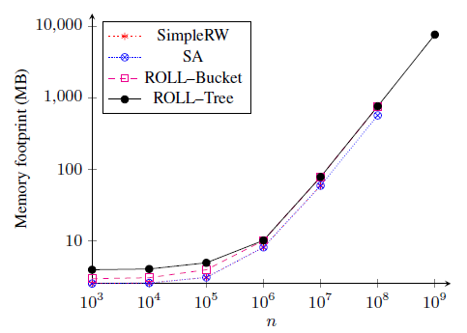
Algorithm
Sample
Maintenance
Analysis
Simple RW
O(n²m)
O(nm)
SA
O(n^{3/2})
O(nm)
Experimental Analysis
ROLL-bucket
O(nm × |B|)
O(nm × |B|)
Memory Footprint Comparison
ROLL-tree
O(nm × |L_{CW}|)
O(nm × |L_{CW}|)
Memory footprint (MB)
n (m = 2)
consume more memory space for the buckets
17
Notes:
SA算法取决于平均接受概率（average acceptance rate）

Slide 25
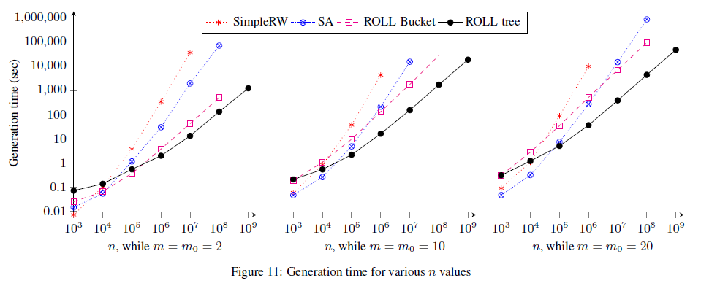
Algorithm
Sample
Maintenance
Analysis
Simple RW
O(n²m)
O(nm)
SA
O(n^{3/2})
O(nm)
Experimental Analysis
ROLL-bucket
O(nm × |B|)
O(nm × |B|)
Performance Comparison
ROLL-tree
O(nm × |L_{CW}|)
O(nm × |L_{CW}|)
Generation time (sec)
n (m = m₀ = 2)
n (m = m₀ = 10)
n (m = m₀ = 20)
ROLL-tree is the only algorithm that grows approximately with n
18

Slide 26
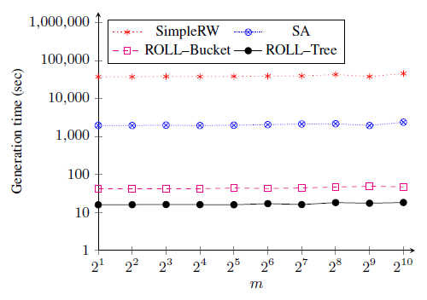
Algorithm
Sample
Maintenance
Analysis
Simple RW
O(n²m)
O(nm)
SA
O(n^{3/2})
O(nm)
Experimental Analysis
ROLL-bucket
O(nm × |B|)
O(nm × |B|)
Performance Comparison
ROLL-tree
O(nm × |L_{CW}|)
O(nm × |L_{CW}|)
Generation time (sec)
m₀
m = 2 , n = 10⁷
independent of m₀
19

Slide 27
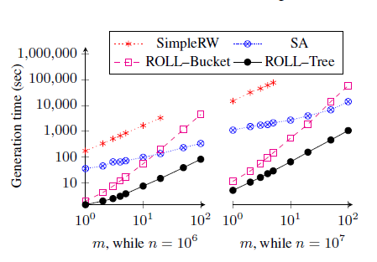
Algorithm
Sample
Maintenance
Analysis
Simple RW
O(n²m)
O(nm)
SA
O(n^{3/2})
O(nm)
Experimental Analysis
ROLL-bucket
O(nm × |B|)
O(nm × |B|)
Performance Comparison
ROLL-tree
O(nm × |L_{CW}|)
O(nm × |L_{CW}|)
Generation time (sec)
m (n = 10⁶)
m (n = 10⁷)
ROLL-tree is outperforming for any m when n is large(n > 10⁶)
20

Slide 28
Outline
Problem Definition
Existing Method
Proposed Method
Analysis
Conclusion

Slide 29
Conclusion
Fast
linear
ROLL-tree
Exact
strictly follow the BA model
Generalizable
applicable to many random process
21

Slide 30
Thank you!

